Slide 1


AtliQ Hospitality Analysis
AtliQ Hospitality is a leading provider of innovative software solutions for the hospitality industry, aimed at streamlining operations, enhancing guest experiences, and driving profitability. This presentation delves into the capabilities, advantages, and potential challenges of AtliQ, providing a comprehensive analysis for hospitality professionals seeking to optimize their operations.
by Abhinav S

Slide 2
Overview of AtliQ Hospitality
AtliQ's Mission
Target Audience
AtliQ is dedicated to empowering hospitality businesses with user-friendly and powerful software solutions. Their goal is to simplify complex operations, optimize resource allocation, and enhance guest satisfaction.
AtliQ caters to a wide range of hospitality businesses, including hotels, resorts, restaurants, and event venues. They provide tailored solutions to address the unique needs of each segment.

Slide 3
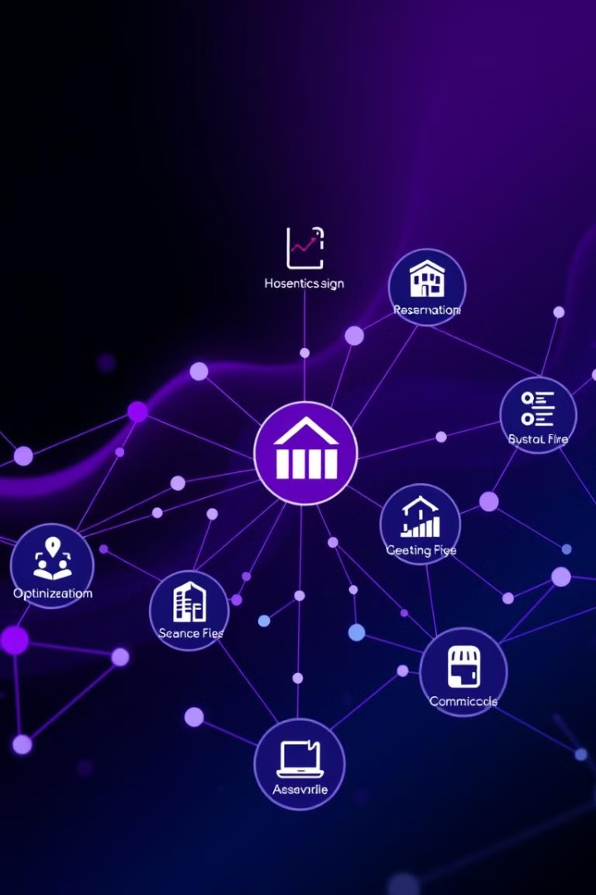
Key Features and Capabilities
Reservation Management
Revenue Optimization
AtliQ's reservation system seamlessly integrates online booking platforms, ensuring efficient room allocation and guest data management.
Advanced algorithms analyze market trends and guest behavior to maximize occupancy and revenue through dynamic pricing strategies.
Guest Relationship Management (CRM)
Property Management System (PMS)
AtliQ's CRM module enables personalized guest interactions, tracking preferences, and fostering loyalty through targeted communications.
The PMS streamlines all aspects of hotel operations, including check-in/out, housekeeping, and staff scheduling.

Slide 4

Operational Advantages of AtliQ
1
Increased Efficiency
2
Enhanced Communication
AtliQ automates repetitive tasks, freeing up staff to focus on enhancing guest experiences and addressing individual needs.
Real-time communication tools facilitate seamless collaboration between departments, ensuring smooth operation and minimizing errors.
3
Data-Driven Insights
4
Improved Guest Satisfaction
AtliQ provides comprehensive data analytics, enabling informed decision-making based on real-time performance indicators.
Personalized services, efficient operations, and seamless guest communication contribute to an enhanced guest experience.

Slide 5





Potential Drawbacks and Limitations
Implementation Complexity
Cost Considerations
Implementing a new system can disrupt existing workflows and require significant training for staff. Careful planning and phased implementation are crucial.
AtliQ solutions can involve upfront licensing fees, ongoing subscription costs, and potential integration expenses. Thorough cost-benefit analysis is essential.
System Compatibility
Data Security
Compatibility issues with existing systems can arise. Ensuring smooth integration with legacy systems requires careful evaluation and potential customization.
Maintaining data security is paramount. AtliQ's security protocols and data encryption measures should be thoroughly assessed.

Slide 6
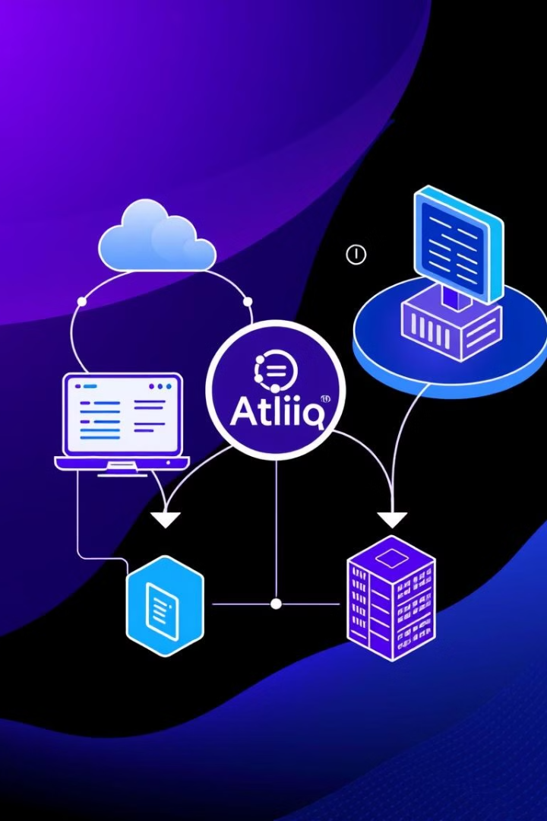
Integrating AtliQ with Existing Systems
1
Assess the current technology landscape, identifying key systems and their capabilities. Analyze data flow and integration points.
2
Evaluate AtliQ's API and integration capabilities. Identify potential compatibility issues and explore available integration tools.
3
Develop a phased implementation plan, starting with pilot testing in specific areas. Provide comprehensive staff training and ongoing support.

Slide 7




Impact on Customer Experience
Personalized Services
AtliQ's CRM module enables personalized guest interactions based on preferences, enhancing the guest experience.
Efficient Operations
Streamlined check-in/out processes, quick room service, and prompt responses to guest requests create a positive experience.
Enhanced Communication
Real-time communication channels empower guests to access information, request services, and provide feedback easily.

Slide 8





Implementation Considerations and Costs
Project Scope
1
Clearly define the scope of the implementation, including specific modules and functionalities.
2
Staff Training
Allocate resources for comprehensive staff training on AtliQ's functionalities and workflows.
3
Data Migration
Plan for data migration from existing systems to AtliQ, ensuring data accuracy and integrity.
Integration Costs
4
Factor in potential costs for integration with existing systems, including customization and support services.
Ongoing Support
5
Consider the need for ongoing support and maintenance, including technical assistance and software updates.

Slide 9
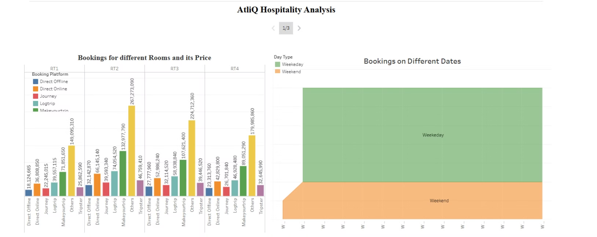
Snapshot 1

Slide 10
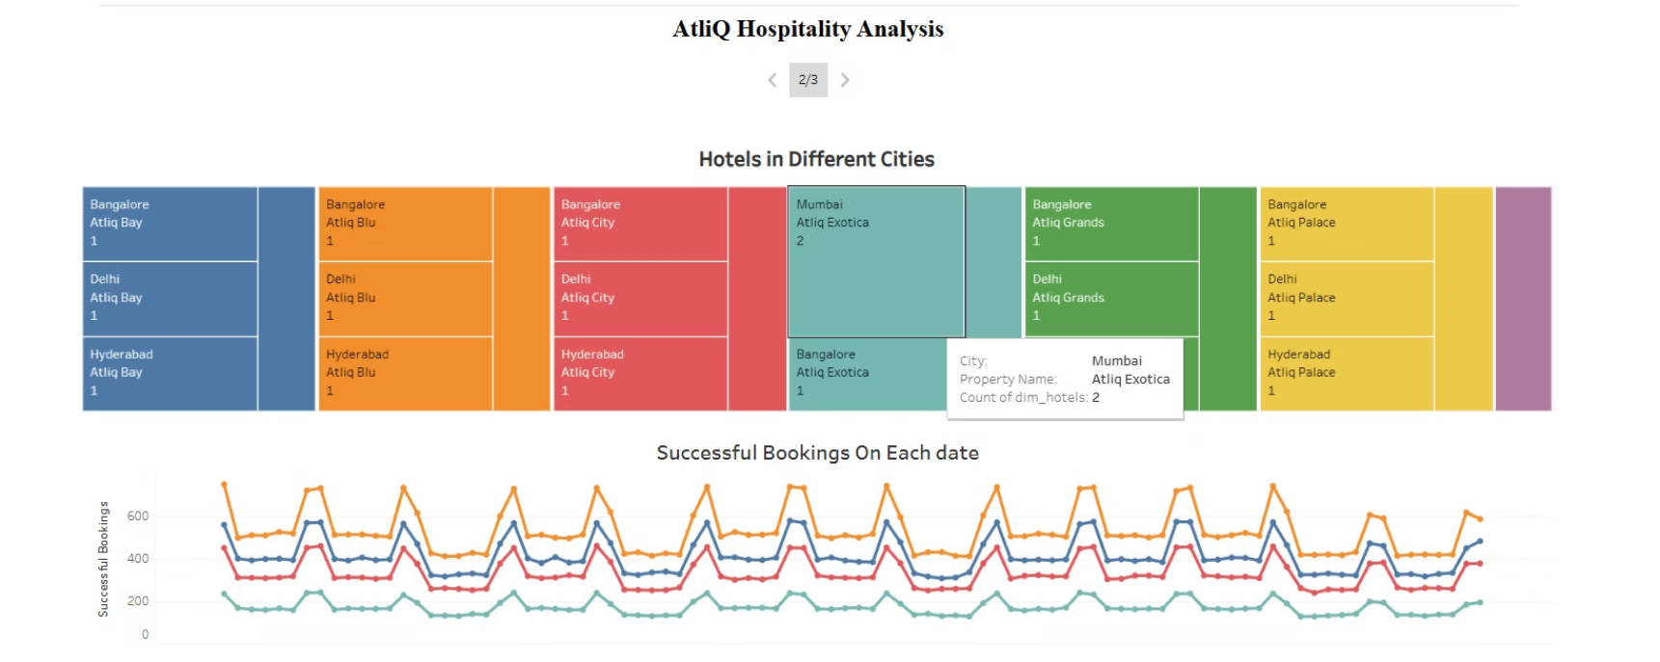
Snapshot 2

Slide 11
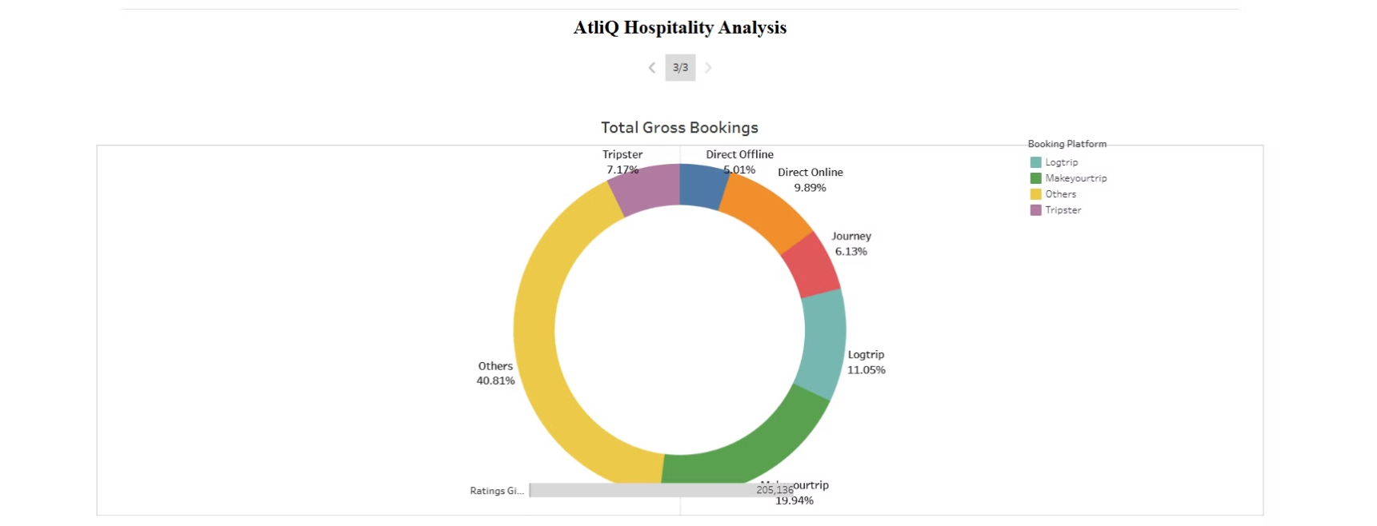
Snapshot 3

Slide 12

Conclusion and Key Takeaways
AtliQ Hospitality offers a comprehensive suite of software solutions that can significantly enhance operational efficiency, guest satisfaction, and profitability for hospitality businesses. While implementation requires careful planning and resource allocation, the potential benefits, as evidenced by real-world case studies, make AtliQ a compelling option for hotels, resorts, restaurants, and event venues seeking to optimize their operations and stay ahead in a competitive industry. By embracing data-driven insights and leveraging technology to enhance guest experiences, AtliQ empowers hospitality professionals to achieve their business goals and deliver exceptional service.

